Slide 1
CS 4530: Fundamentals of Software Engineering Activities for Week 3: Process
Jonathan Bell, Adeel Bhutta, Ferdinand Vesely, Mitch Wand
Khoury College of Computer Sciences
© 2022 Released under the CC BY-SA license

Slide 2
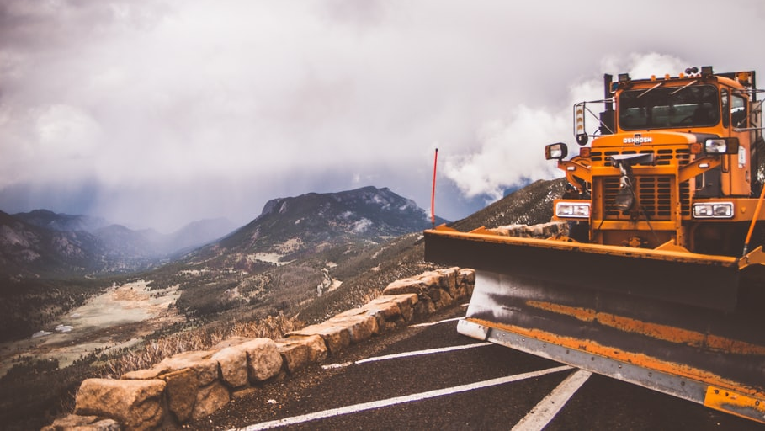
Lesson 3.1 Activity: Generating User Stories
The City of Boston is creating a new app to track plow activity and plan plow routes during winter storms
They don’t know what features to include, and can imagine lots of different kinds of users:
Plow operators, city officials, business owners, different citizens
We’ll brainstorm user stories: As a <role> I want <capability> so that <receive benefit>
Optionally also conditions of satisfaction: Given <interaction with software, state of environment>, I expect <behavior and side effects>
Notes:
<read slide>
Choose how to get responses from students: Call them out and write them on board, or use poll everywhere, shared google doc, whatever…
Think about your own example to give to seed the discussion, or use “Prof Bell wants to find out which streets are NOT plowed so that he can go cross-country skiing on them, which he thinks is fun.”
Expected time: 15 minutes to work on activity, 5-10 minutes to review and discuss
Learning Objectives that you should think about while leading discussion:
Students recognize the importance of considering different roles for user stories.
Students recognize the importance of conveying the value behind a user story, because not everyone in the room will necessary understand what the value is, but you can share it. Example: “Prof Bell wants to find out which streets are NOT plowed so that he can go cross-country skiing on them, which he thinks is fun.”
Analyze the students’ user stories critically using the INVEST framework
Independent – Stories should not be coupled between each other, except where obviously necessary. Want to make it so that a user can examine a story on its own
Negotiable – Best stories are result of a negotiation between a client and a developer – how do we come to some utual agreement about what we are going to build, and why? Goal is to develop what the customer needs
Valuable – Each story should have some benefit that the user can recognize. Value might include value to your business, not just value to the user.
Estimable – As we will see in a bit, being able to estimate how long it will take to implement a user story is key to determining a reasonable scope for your project
Small – A rule of thumb is to average 3-4 days of work per-story. Again, we’ll see this fit in with estimation.
Testable – There must be some way to judge completion: for the person implementing the software, and for the end-user.

Slide 3
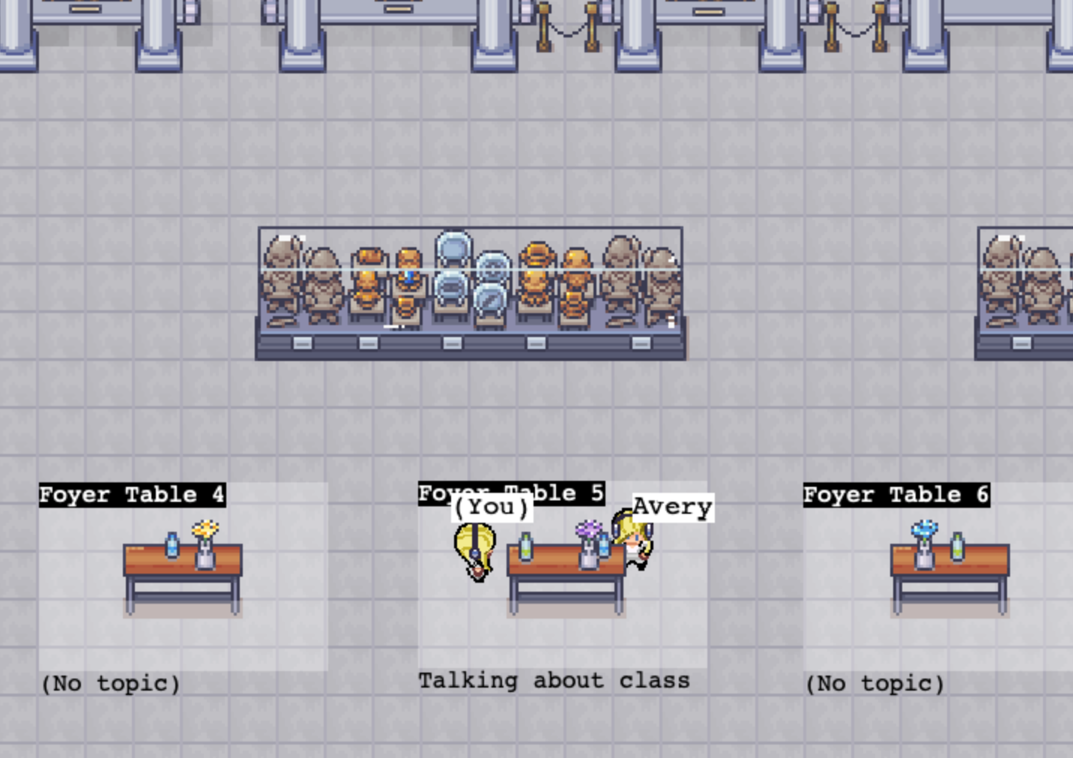
Lesson 3.3 Activity: Defining and Estimating Implementation Tasks
HW2 adds a new feature to Covey.Town: “Conversation Areas”
“As a user of covey.town I want to be able to label a dedicated space to have a conversation about a topic so that people will know that I want to talk about that topic”
You can view this feature implemented (through HW2) at https://app.covey.town
Brainstorm 2-3 additional user stories that are not yet implemented, but are related to “conversation areas”
Attempt to decompose those user stories into tasks, and estimate them as Small, Medium, or Large
Notes:
<read slide>
Choose how to get responses from students: Call them out and write them on board, or use poll everywhere, shared google doc, whatever…
Give this ~20 minutes for work, 10 minutes for discussion
The best idea will become HW4! ☺
Analyze the students’ user stories critically using the INVEST framework
Independent – Stories should not be coupled between each other, except where obviously necessary. Want to make it so that a user can examine a story on its own
Negotiable – Best stories are result of a negotiation between a client and a developer – how do we come to some utual agreement about what we are going to build, and why? Goal is to develop what the customer needs
Valuable – Each story should have some benefit that the user can recognize. Value might include value to your business, not just value to the user.
Estimable – As we will see in a bit, being able to estimate how long it will take to implement a user story is key to determining a reasonable scope for your project
Small – A rule of thumb is to average 3-4 days of work per-story. Again, we’ll see this fit in with estimation.
Testable – There must be some way to judge completion: for the person implementing the software, and for the end-user.

Slide 4

Lesson 3.4 Activity: What makes a strong team?
Reflecting on your past experiences and the HRT pillars that we discussed in today’s lesson, what attributes do you want in your teammates? How would you “interview” a new teammate?
Pillar 1: Humility: You are not the center of the universe (nor is your code!). You’re neither omniscient nor infallible. You’re open to self-improvement.
Pillar 2: Respect: You genuinely care about others you work with. You treat them kindly and appreciate their abilities and accomplishments.
Pillar 3: Trust: You believe others are competent and will do the right thing, and you’re OK with letting them drive when appropriate.
Notes:
<read slide>
Choose how to get responses from students: Call them out and write them on board, or use poll everywhere, shared google doc, whatever…

